Slide 1
Computer and Network Forensics
Foundation: Network Intrusion Detection and Analysis
Sowndarya Krishnamoorthy, 104654482, School of Computer Science

Slide 2
Adapted From
Copyright © 2012 Pearson Education, Inc.
All rights reserved.

Slide 3
OUTLINE
Introduction
Why investigate IDS/IPS
NIDS/NIPS functionality
Modes of detection
Types of NIDS/NIPS
NIDS/NIPS evidence acquisition
Comprehensive packet logging
Snort
- Basic architecture
- Configuration
- Rules Language
Summary

Slide 4
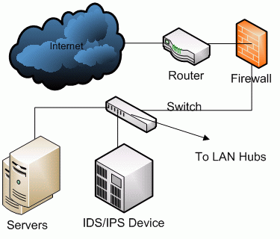
INTRODUCTION
Intrusion Detection System (IDS) inspects all inbound and outbound activities and attacks from someone attempting to compromise a system
Intrusion Prevention System (IPS) provides rules to perform an action upon being alerted due to suspicious traffic
The IDS/IPS has two classifications:
- Network Intrusion detection/prevention systems (NIDS/NIPS)
- Host Intrusion detection/prevention systems (HIDS/HIPS)
NIDS/NIPS monitors the network and alerts on suspicious events and traffic
HIDS/HIPS monitors the system and
alerts on suspicious system events
and activities

Slide 5
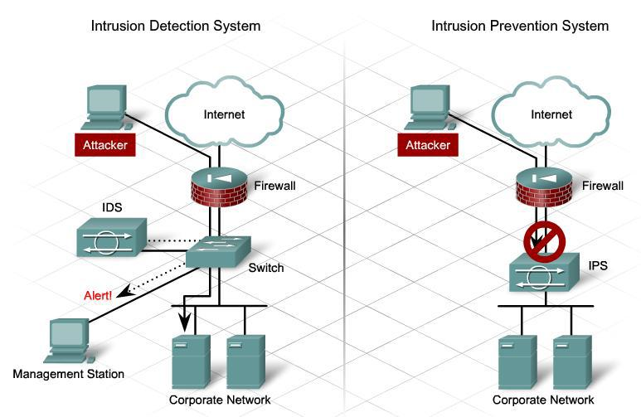
Figure: Intrusion detection system identifies the attack and triggers an alert to the management station where it will be monitored by an administrator. Intrusion prevention system performs an action based on the rules defined to prevent the attack.

Slide 6
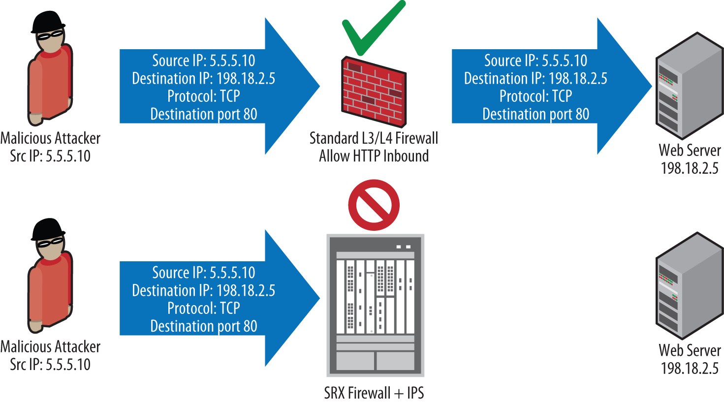
WHY INVESTIGATE IDS/IPS?
NIDS/NIPS alerts suspicious connections or illegal attempts which are not recorded even in the application layer
It can be configured to log traffic which firewall considers acceptable
- For example, port-80 connection containing a malicious URL to a web server is recorded which firewall cannot log.
NIDS/NIPS serve as well-positioned inspection points to monitor traffic
An investigator could
potentially alter a NIDS/NIPS
setup to start recognizing
events it wasn't previously
designed to record.

Slide 7
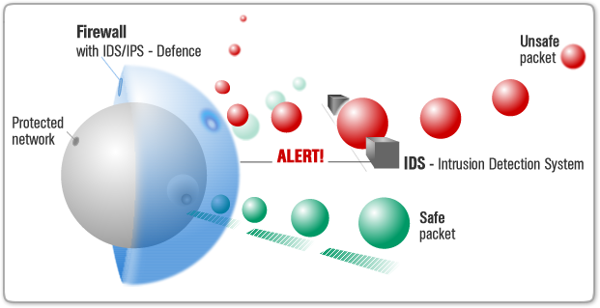
NIDS/NIPS FUNCTIONALITY
NIDS/NIPS are specialized sniffers capable of evaluating the captured traffic as legitimate or not
There are many commercial systems on market behaving differently but with the same NIDS/NIPS features
NIDS/NIPS comprises:
- Rules has the descriptions to compare the TCP packets or UDP streams with the known malicious traffic
- Alerts are sent to the administrator for investigation if system files are modified or packets/streams are found suspicious
- Packet Captures can be
configured to capture suspicious
packets and save them for further
analysis

Slide 8
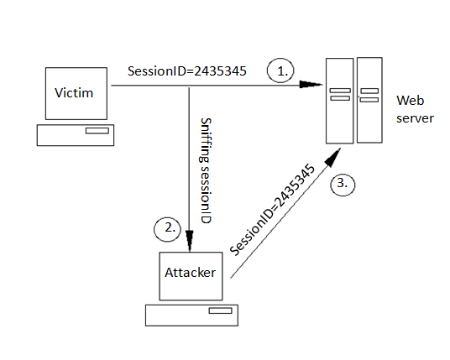
NIDS/NIPS FUNCTIONALITY: SNIFFING
NIDS may have access to network traffic by connecting to a mirroring port on a switch, through the use of an inline tap or placing the NIDS/NIPS itself inline between two devices in a choke point position
Sniffing passively does not cause the traffic to be detained but is merely copied on its way with little or no delay
- If the device is actively filtering the traffic it causes a noticeable latency delay
Sniffing can be performed during the investigation of traffic particularly in ways that
weren’t being done
previously but modifying it
causes disruption to business

Slide 9
NIDS/NIPS FUNCTIONALITY: HIGHER-LAYER PROTOCOL AWARENESS
Attackers began to break malicious traffic into multiple pieces, or encode traffic in sneaky ways, in order to evade detection
NIDS/NIPS incorporated higher layer protocol awareness in two ways:
- protocol reassemble
- normalization
Attackers evade detection by fragmenting the traffic so that the end recipient of traffic would reassemble the fragments sent in the TCP stream
Protocol Reassemble understands TCP’s statefulness and performs stream reassembly prior to performing content inspection.
- If the legitimate port 80 connection contains a malicious request, the firewall cannot detect it.
- The NIDS/NIPS understands the HTTP protocol to look inside the request alerts if it contains some malicious URL

Slide 10
NIDS/NIPS FUNCTIONALITY: HIGHER-LAYER PROTOCOL AWARENESS
Normalization refers to various ways of encoding the data for certain types of traffic, notably HTTP
The following GET request is an example of ‘directory traversal’ attack as it traverses to document hierarchy and displays the system /etc/passwd file
GET /../../../../etc/passwd HTTP/1.1 GET %2f..%2f..%2f..%2f..%2fetc%2fpasswd HTTP/1.1 GET%2f%2e%2e%2f%2e%2e%2f%2e%2e%2f%2e%2e%2f%65%74%63%2f%70%61%73%73%77%64 HTTP/1.1
However, there infinite number of ways to encode any particular malicious string, two such options are:
- write a ‘signature’ to detect all ways of string representation
- first ‘normalize’ each string to its canonical form, and then compare them against the suspicious list

Slide 11
NIDS/NIPS FUNCTIONALITY: ALERTING ON SUSPICIOUS BITS
NIDS/NIPS can be configured to communicate alerts via different means:
- Sending email alerts
- Logging events to a syslog server
- Sending SNMP traps
- Logging events directly to a queriable database
- Storing alerts and events through NIDS/NIPS sensors
Fidelity is the manner in which alerts are recorded and delivered as it can be of great evidential value
- ‘lo-fidelity’ refers to alerts logged via syslog or SNMP traps which has less event details
- ‘hi-fidelity’ refers to capturing and storing the packets in their entire format (usually in libpcap format).

Slide 12
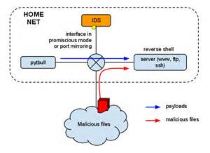
MODES OF DETECTION
NIDS/NIPS has three ways of operation:
- signature-based analysis
- protocol awareness
- behavioural analysis
Signature-Based Analysis looks at headers, contents and streams of packets against databases of known, malicious byte sequences with a specific end goal to distinguish suspicious activity
- It not only inspects
single packet but also
multiple fragments of
packets related to
malicious activity
- It is the oldest and
commonly used strategy

Slide 13
MODES OF DETECTION
Protocol Awareness reassemble fragments (Layer 3), reassemble streams (Layer 4), and even reconstruct whole protocols (Layer 7) to understand the endpoint communication of data
- Normal traffic conforms to RFC specifications while malicious traffic does not
- Protocols can also be broken due to a malfunctioning device. Any sort of protocol abuse denotes malicious intent. In any case, it is worth identifying
Behavioural Analysis compares the normal network behaviour to the future behaviour.
- For example, alerts may be triggered if the volume of data going out of server is usually greater, though there is no protocol violation or content of web transactions exhibit bad behaviour

Slide 14



TYPES OF NIDS/NIPS
There are two types of NIDS/NIPS:
- Commercial
- Roll your own
Commercial NIDS/NIPS are made from special hardware designed to improve performance
Marcus Ranum’s NFR (Network Flight Recorder) NIDS offered an open language for specifying packet and traffic signatures, allowing NFR Security’s customers to build their own custom rules
The commercial market for IDS is very much alive

Slide 15
TYPES OF NIDS/NIPS
Other commercial products are:
- Cisco’s Secure IDS has morphed into Cisco IPS
http://www.cisco.com/en/US/products/sw/secursw/ps2113/index.html
- Enterasys’ Dragon is now Enterasys IPS
http://www.enterasys.com/products/advanced-security-apps/dragon-intrusion-detection-protection.aspx
- IBM’s Internet Security Systems (ISS) RealSecure sensor has morphed into the IBM Security NIPS (Trivoli enterprise management tool)
http://www-01.ibm.com/software/tivoli/products/security-network-intrusion-prevention/
- Hewlett-Packard subsumed TippingPoint’s product
- Sourcefire is the commercial vendor/licenser of Snort which is open source and leads the NIDS/NIPS market

Slide 16
TYPES OF NIDS/NIPS
Roll your own NIDS are often built from open-source software such as Snort, which gives users the option to download free signature updates, or purchase a subscription that provides more timely access to updates
- They can be refactored or repurposed during an investigation, and custom solutions can be found
For a long time Snort was the open source software under the GNU Public License (GPL) but eventually the Bro system is also gaining both in competitiveness and adoption
Snort is much more targeted toward enterprise and production deployment.
http://www.snort.org/
Meanwhile Bro system is developed primarily as a research platform for intrusion detection and traffic analysis
http://bro-ids.org/

Slide 17
NIDS/NIPS EVIDENCE ACQUISITION
The precise evidence that forensic investigators can gather can vary considerably depending on the hardware and software used to build NIDS/NIPS. The different types of evidence are:
- Configuration
- Alert data
- Packet header and/or flow record information
- Packet payloads
- Activities correlated across multiple sensors
Configuration of NIDS/NIPS is essential for any analysis of alerts from the device
- The meaning of the alert can’t be determined with certainty unless knowing which rule triggered the alert
- IDS system doesn’t show where the device is placed and what it has been configured to alert

Slide 18
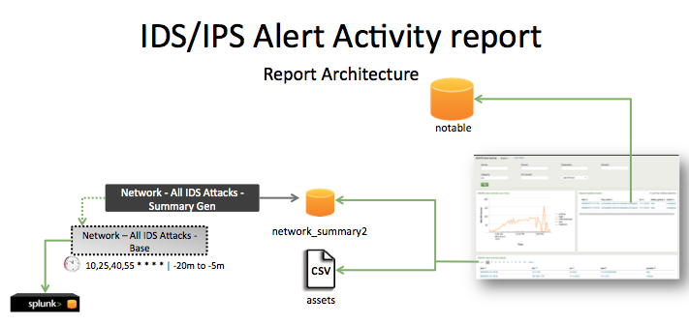
NIDS/NIPS EVIDENCE ACQUISITION: TYPES OF EVIDENCE
Alert data allows humans to act upon based on a set of rules, learned patterns or traffic of interest. Type of alerts are:
- text files
- emails
- messages in GUI
Alerts from multiple sources
are difficult to categorize and prioritize
- Security Information and Event Management (SIEM) systems normalize the event data from disparate sources but often ends up being solved by humans
Packet header information is logged when corresponding packet or flow triggers a NIDS/NIPS alert.
- Identifies the origin, destination, patterns of activity and correlates events from multiple sources

Slide 19
NIDS/NIPS EVIDENCE ACQUISITION: TYPES OF EVIDENCE
Content Data or full payload information is monitored to identify the malware that triggered an alert or view the actual obfuscated JavaScript that an attacker attempted to serve a client
- It is difficult to figure out the nature of events associated just like sorting out large volumes of data resulting in more processing power
Activities Correlated Across Multiple Sensors is exceptionally useful but is not available at all times
- Few organizations aggregate security event data to correlate NIDS/NIPS data but require more expensive staff and skills to monitor and maintain
Enterprises deploy NIDS/NIPS sensor instrumentation and direct all output to a third-party monitoring service hence the events must be correlated

Slide 20
NIDS/NIPS EVIDENCE ACQUISITION: INTERFACES
NIDS/NIPS evidence can be obtained to manually aggregate and correlate the data through:
- graphical user interface (GUI)
- command-line interface (CLI)
- remote log server
GUI Interfaces can be accessed by a web client, or a proprietary interface that requires a special client to access, inspect and configure NIDS/NIPS
- Some vendors allow exposure to all functionality such as from signature configuration, alerts generation, and actual packet traces download.
Command-Line interfaces can view NIDS/NIPS configuration logs and alerts via SSH or direct console connection

Slide 21
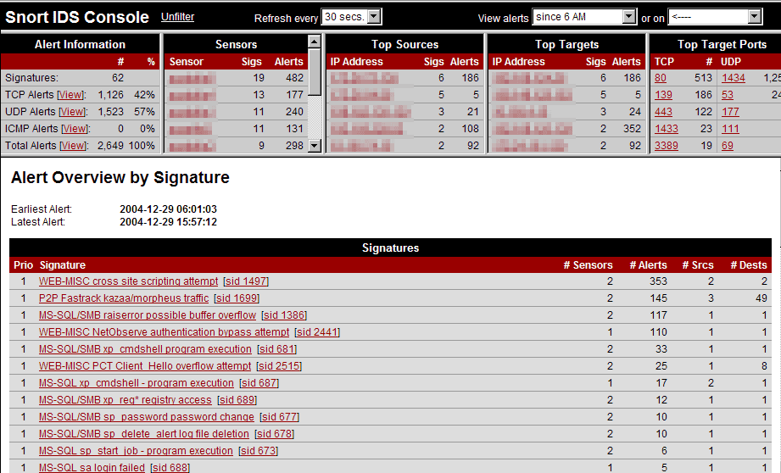
NIDS/NIPS EVIDENCE ACQUISITION: INTERFACES
Figure: Snort IDS Console containing alert and sensor information

Slide 22
NIDS/NIPS EVIDENCE ACQUISITION: INTERFACES
Some devices have constrained access of functionality to command-line while others expose entire application programming interfaces (APIs) for nearly infinitely extensible customizations
- For example, Sourcefire’s NIPS sensors allows the same version of Snort to be downloaded for free
- They provide a library of custom Perl objects that can be used by anyone
Off-System Logging sends some of the critical evidence to an aggregation repository, alerting via email to system administrators
- NIDS/NIPS configuration inspection is required in order to find where the system is sending traffic logs
- Local device configuration will also provide an understanding of the level of detail and fidelity of the remote logging

Slide 23
COMPREHENSIVE PACKET LOGGING
NIDS/NIPSs record the total packet content from metadata to the payload contents unlike routers and firewalls which log the packet event with source and destination information
- NIDS/NIPS generally are not configured to capture the packets that preceded an incident, nor the ones that follow
To encounter this problem: construct a persistent packet sniffing device to record every one and zero that traverses the link
- Ensures if it has recorded all data with accurate timestamp
NIDS/NIPS captures single packet per event located in comprehensive packet log
- If it was a stateful session, the stream can be reconstructed
- If it was a stimulus, the response may be investigated
- If it was a response, the stimulus can be determined

Slide 24
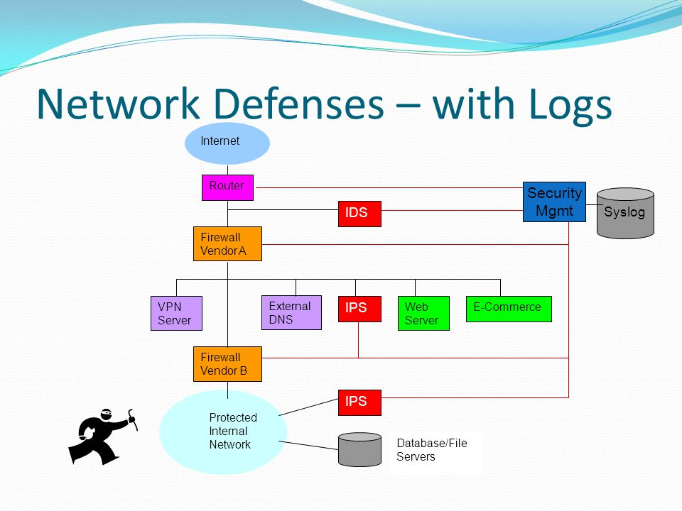
COMPREHENSIVE PACKET LOGGING
However, logging requires a lot of CPU, more disk space and can pose as a security risk
Figure: IPS captures all the metadata to Syslog through packet logging

Slide 25
COMPREHENSIVE PACKET LOGGING: EVIDENCE AVAILABLE
Many tools can be configured to adjust skew either on input or display to aggregate absolute time (GMT-0). Evidence available are through:
Packet headers
– Suitable for traffic analysis
– Similar to pen registers, trap/trace
Packet payloads
– Suitable for full transaction reconstruction
– Similar to full wiretap
Entire sessions can be reconstructed and used in conjunction with other event data if full payloads are stored which lead to perfect fidelity
Packet capturing is performed with tcpdump and analysis of the logs is usually performed with libpcap-based tool

Slide 26

SNORT
Snort is an open-source commercial most widely distributed NIDS product in the world
- It is a libpcap-based utility to perform much deeper packet inspection rather than being limited to layer 2 and layer 4 analysis
Arbitrary network traffic can be analysed through:
- protocol analysis
- signature analysis
The rule language is open source to know how rules are written to find individual packets
Snort finds everything even there is so
much traffic unlike tcpdump

Slide 27
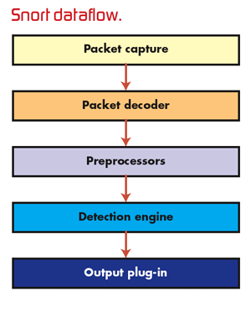
SNORT: OVERVIEW
Most widely used NIDS
Open-source code
Open rule language
Extremely versatile
Actively improving, partly due to
commercial support
Snort has its-
- Basic Architecture
- Configuration
- Rule Language
Rob Lee says, “If you know what
you’re looking for and where to
look, nothing is hidden.”
Figure: Illustrates the snort dataflow with packet capture from stream

Slide 28
SNORT: BASIC ARCHITECTURE
Snort pulls packets in using libpcap, from whichever interface is specified, either at the command-line or in the configuration file
Snort passes all packets through preprocessors for reassembly and protocol analysis. These preprocessors roughly mirror the OSI layers:
- At Layer 3, it reassembles fragments
- At Layer 4, it reassembles streams
- At Layer 5, it reassembles circuits/sessions
- At Layer 7, it reassembles transactions
In any of these layers, if Snort detects anomalies, it can alert
Once the preprocessing is completed, the analyzed information is handed off to the Snort rule engine

Slide 29
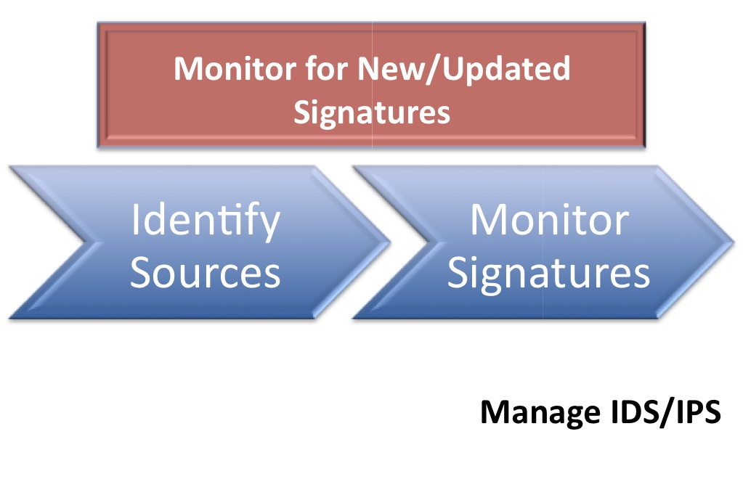
SNORT: BASIC ARCHITECTURE
The rule engine uses all of the protocol information and the payload contents (parsed or raw) to detect malicious traffic
Then, the output engine is invoked to determine how the resulting alerts will be communicated to the end-user
- Snort’s native text-based to syslog and SNMP alerting happens from any triggers
Packets trigger alert through:
- Preprocessors
- Signatures
Snort can be configured to capture subsequent related traffic
The cause of an alert can be further investigated by analysts

Slide 30
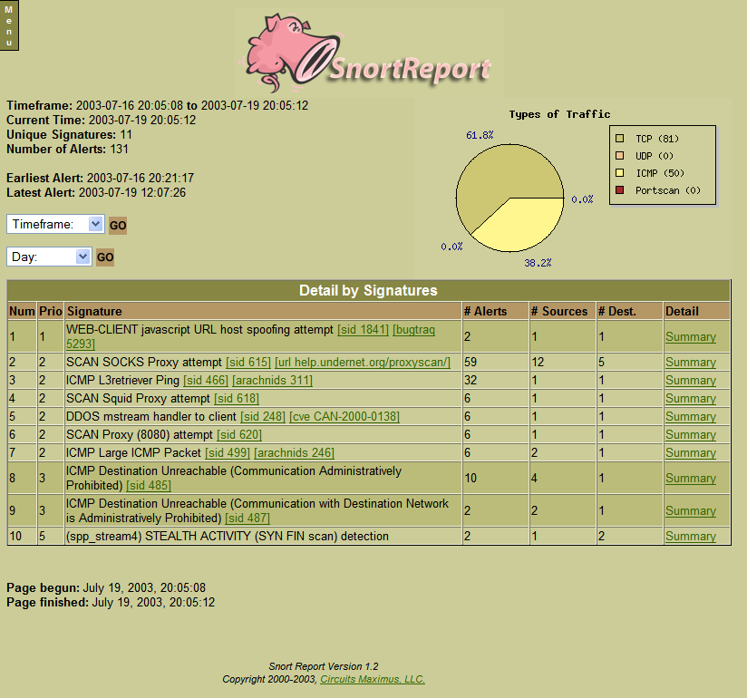
SNORT: BASIC ARCHITECTURE
Figure: Snort packets trigger alert through signatures and report their information

Slide 31
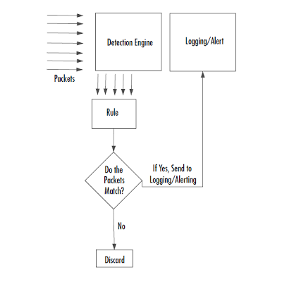
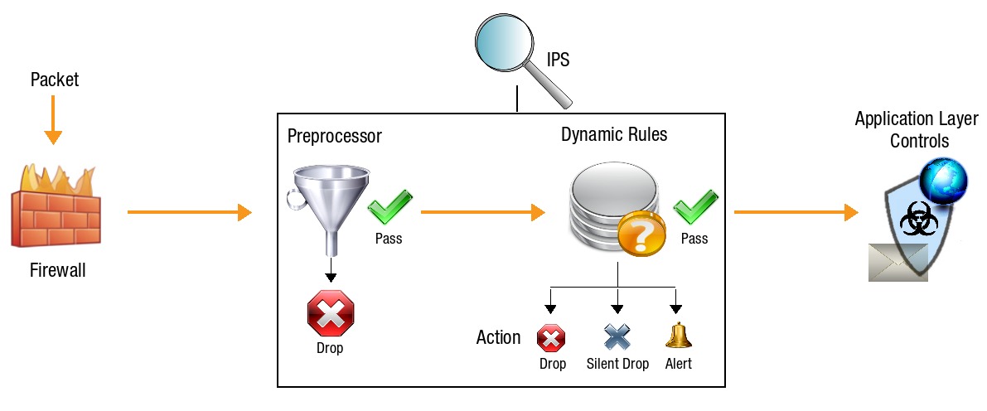
SNORT: BASIC ARCHITECTURE
Figure: Preprocessor and Detection Engine filtering based on rules

Slide 32
SNORT: CONFIGURATION
The Snort files and directories on Linux systems are in:
- /etc/snort/snort.conf The file is where global values (internal/external network definitions) for Snort are declared, the output processors are configured for logging, and the major chunks of rules are included
- /etc/snort/rules/ Directory has rules which can be enabled or disabled
- /var/log/snort/ Directory has native alerts file, where Snort records text-based alerts, and the libpcap files with corresponding packet captures.
The locations of these Snort files/directories are fully configurable.

Slide 33
SNORT: RULE LANGUAGE
Sourcefire’s Vulnerability Research Team (VRT) distribute files which contains numerous rules defined by text based language (one line per rule)
All rules contain a Snort ID (SID) which identifies that particular rule.
- SIDs < 1 million are reserved for the Sourcefire
- SIDs between 1 and 2 are reserved for freelance (open source community called Emerging Threats)
- SIDs > 2 million are for local rules to be built
While creating customized rules, copy the existing rule and disable commercial rule and enable modified local version
Based on payloads different rule options can be used:
- Nonpayload Detection Rule Options
- Payload Detection Rule Options

Slide 34
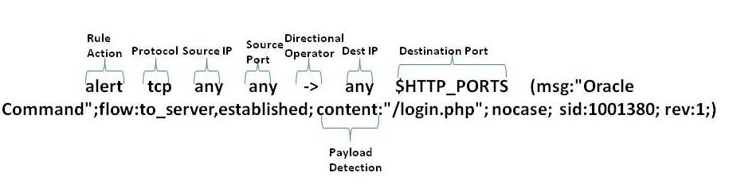
SNORT: RULE HEADER
Snort rule header consists of seven fields, space delimited, as follows
- Action: describes what the snort sensor must perform when a packet is found as a match. Typical actions are alert, log, pass, and drop
- Protocol: delineates the protocol the packet must be employing to match the rule with values like icmp,tcp,udp or ip
- Source IP and Port: describes qualified source of a packet
Figure: Snort Rule Header containing seven fields with an example

Slide 35
SNORT: RULE HEADER
- Directionality operator: specifies whether a match can occur in one direction only (from source to destination) or bidirectionally by rule author. The allowed values are ‘->’ and ‘<>’
- Destination IP and Port: describes qualified destination of a packet
Here are examples of Snort rule headers-
alert tcp any any -> 192.168.2.1 80 (...)
- Alert if match is found for any TCP segment from any source at all and that is destined specifically to port 80 on host 192.168.2.1
log udp 192.168.1.1 53 -> !192.168.1.0/24 any (...)
- Alerts for UDP that is destined except 192.168.1.0/24 network
drop ip $EXTERNAL_NET any <> $HTTP_SERVERS $HTTP_PORTS (...)
- Drops packet if match is found for any IP packet coming from an external source and destined for predefined HTTP servers

Slide 36
SNORT: RULE BODY
Snort rule body consists of a semicolon-delimited list of rule “options” bracketed by parentheses:
General options (metadata about events) provide a way of specifying information about the rule, it’s purpose, revision, etc
Detection options (stepwise instructions for matching packets or streams) include:
- nonpayload detection specifications (based on Layer 3 and Layer 4 protocol fields) such as: TTL, TOS, sequence and ack numbers (for TCP), ICMP types and codes, etc
- payload” detection specifications (based on Layer 5 content and above in IPv4) such as: content, pcre (Perl-compatible regular expression), depth, offset, etc
Post-detection options actions to take if a match occurs

Slide 37
SNORT: GENERAL RULE OPTIONS
The metadata about events include:
- msg: This is the descriptive title that will be attached to any resulting alerts. It should make clear to the intrusion analyst what the event is about, at a glance
- sid: The required Snort ID number that uniquely identifies the rule
- rev: The rule’s revision number. The combination of “sid” and “rev” define rules uniquely
- reference: An optional pointer to background information, often a CVE number, Bugtraq ID, or URL. While not required, this option is typically one of the most useful metadata options, as it can help the analyst understand why a rule was written in the first place, and what it is testing.
Some options are optional but not all

Slide 38
SNORT: Nonpayload Detection Rule Options
Nonpayload detection rule options include:
Comparison operators for all of the protocol fields in the:
– IP packet header (TTL, fragmentation information, embedded protocol, IP options, etc.)
– TCP segment header (TCP flags and stateful flow inspection, sequence, and acknowledgment numbers, window size, etc.)
– ICMP header (ICMP type and code, sequence values)
Comparison operators for sameip, stream_size, RPC call number
These options are the most reliable for the Snort engine to evaluate, as they operate on data that has already been structurally parsed and preserved
- For example, use of flow tracking by the TCP state engine

Slide 39
SNORT: Payload Detection Rule Options
Payload detection rule options include:
Content matching for:
– ASCII strings
– Binary sequences
– PCREs
Layer 7-specific protocol data, such as HTTP URIs and SMTP commands
Absolute- and relative-positional searches, based on previous content matches
The payload contents can be matched against ASCII strings, hexadecimal (binary) sequences (non-ASCII encodings), and also Perl-compatible regular expressions (PCRE)
Layer 7 protocol awareness comes built in

Slide 40
SNORT: Post-Detection Rule Options
The ability to translate rule matches into specific actions by rule authors on a rule-by-rule basis overrides the global Snort configuration
Such actions include:
- Different handing for alert and packet logging for a given rule
- Triggering the capture of some or all of the subsequent packets in a stream
- performs after a single packet has caused a rule to fire
- Active response mechanisms
-bidirectional reset of TCP connections and the sending of ICMP Destination Unreachable packets, spoofed at each end of the virtual circuit

Slide 41
SNORT: EXAMPLE 1
Snort Rule #1
alert icmp $EXTERNAL_NET any -> $HOME_NET any (msg:"ICMP PING"; icode:0;itype:8; classtype:misc-activity; sid:384; rev:5;)
- a rule will alert on any inbound ICMP traffic of type 8, echo request code 0, and fifth revision of VRT’s number
Snort Packet #1
03:12:08.359790 IP 10.0.1.10 > 10.0.1.254: ICMP echo request, id 32335,seq 0, length 64 0x0000: 4500 0054 eac8 0000 4001 78d9 0a00 10a E..T....@.x..... 0x0010: 0a00 01fe 0800 75e4 7e4f 0000 e801 e349 ......u.~O.....I
- ICMP packet that is an Echo Request. If we presume that 10.0.1.10 is part of the $EXTERNAL NET definition, and 10.0.1.254 is within the $HOME NET range, we would expect a match and an alert.

Slide 42
SNORT: EXAMPLE 1
Snort Alert #1
[**] [1:384:5] ICMP PING [**] [Classification: Misc activity] [Priority: 3] 04/13-03:12:08.359790 10.0.1.10 -> 10.0.1.254 ICMP TTL:64 TOS:0x0 ID:38125 IpLen:20 DgmLen:84 Type:8 Code:0 ID:32335 Seq:1 ECHO
The first and last are ASCII representations of the pig’s snout
Generator ID (GID) specifies the part that produces the alert
- If GID is “1” it denotes the Snort rule engine
The fourth line has Layer 3 header data which includes encapsulated protocol (ICMP), time-to-live value, TOS, IP header and total datagram length
The last line has higher-layer (encapsulated) protocol information such as ICMP code, type and identification

Slide 43
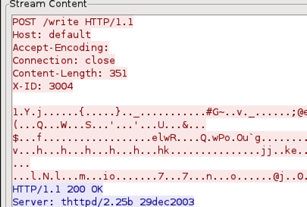
SNORT: STREAM CONTENT
Figure: SNORT Stream content for TCS connections

Slide 44
SNORT: EXAMPLE 2
Snort Rule #2
alert tcp $EXTERNAL_NET any -> $HTTP_SERVERS $HTTP_PORTS (msg:"WEB-MISC /etc/passwd"; flow:to_server,established; content:"/etc/passwd";nocase; classtype:attempted-recon; sid:1122; rev:5;)
- Snort will next evaluate whether the string “/etc/passwd” is found within the packet payload if condition is met
- match can only occur on a properly stateful TCP segment sent in an established connection
Snort Packet #2
05:11:46.015420 IP 192.168.1.50.38097 > 172.16.16.217.80: P2098193630:2098193743(113) ack 1055208924 win 1460 <nop,nop,timestamp109823750 109820452>
0x0030: 068b ba24 4745 5420 2f706173 ...$GET./etc/pas

Slide 45
SNORT: EXAMPLE 2
- The packet contents will be inspected for the string ‘/etc/passwd’ if the packet contains a segment in an established TCP stream
- If packet matches the rule, then the system will log an alert with the message ‘WEBMISC /etc/passwd’
- Inspecting the payload, the string is a part of GET request
Snort Alert #2
[**] [1:1122:5] WEB-MISC /etc/passwd [**] [Classification: Attempted Information Leak] [Priority: 2] 04/06-05:11:46.015420 192.168.1.50:38097 -> 172.16.16.217:80 TCP TTL:64 TOS:0x0 ID:9181 IpLen:20 DgmLen:165 DF ***AP*** Seq: 0x7D0FE4DE Ack: 0x3EE535DC Win: 0x5B4 TcpLen: 32 TCP Options (3) => NOP NOP TS: 109823750 109820452
- rule caused the alert due to its SID (1122) and revision no (5)

Slide 46
SUMMARY
NIDS/NIPS are particularly intended to filter through a lot of system activity and select particular events of intrigue, especially those that identify with security
They are regularly the primary spot investigators turn for data on a case.
NIDS/NIPS alerts are regularly the triggers that cause the examination to be propelled by investigators
Discussed about NIDS/NIPS functionality which includes sniffing and higher-layer protocol analysis
Examined the modes of detection, different types of NIDS/NIPS, various evidences and logging
Reviewed about the open source NIDS/NIPS Snort and discussions about it rules, alerts and captured packets

